Slide 1
WHMIS-2015
General information on registration,
online test,
and certification

Slide 2
Useful links
What is WHMIS-2015, and Where is the course link?
Please go here: http://www.mcgill.ca/ehs/training/whmis
Step by Step online registration process
In order to register you will need:
McGill Id or McGill username.
Minerva Pin or McGill Password.
Then you have to view the Training Calendar (for Live Course)
There is currently no online course

Slide 3
Certification
After completing your online WHMIS 2015 test, please keep your e-results until you receive your e-certificate. That email serves as proof of training and allows you to enter laboratory.
Approximately one month the completion of the course/test, EHS will do its best to forward you an e-certificate. Sometime, due to busyness, it may take longer. To stay tune on updates, please visit this page. If the information is not updated, simply email ehs@mcgill.ca.
The certification is valid for a three year period. Should you need to maintain your WHMIS 2015 certification, you will need to challenge the test again (in person). If you get the passing grade set at 80%, EHS will extend your certification for another three years. If you fail, you will be required to assist to a Live Course.

Slide 4
How to determine what type of registration I need?
to a Live Course?
It is the mandatory if it is the first time you do this certification. This registration includes an online test [and re-write if needed]. No additional exam test registration will be necessary [including for the re-write].
Note: EHS recognize other university/institution Live course certification; but not online. Read more here, 5th paragraph.
to an “in person” exam?
If our Live course offering conflicts with your schedule, and
if you have failed once already, EHS offers in person test session to accommodate you (at EHS office).

Slide 5
Useful links
To better prepare myself for the test, I can:
Download and study the course notes (pdf slide presentation)
Please go here: http://www.mcgill.ca/ehs/training/presentations
Read carefully the instructions found on the EHS webpage to access them.

Slide 6
What to write in the online test heading
Name and ID: put yours
Department: i.e. the location of the laboratory
EHS doesn’t need the name of your diploma
PI (principal investigator): your professor
PI email: Professor one
it could be your TA, as per Prof. instruction
It could be your School Advisor if not yet assigned to a professor/project
Building & Lab room #: put yours [if this is not applicable – write “NA”)

Slide 7
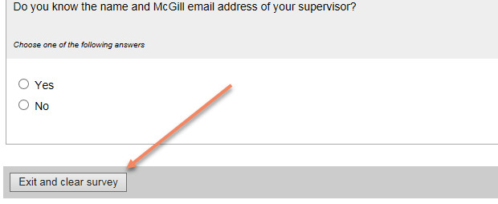
Useful hints for online test
You have accessed your online test, but realized that you do not have the 1 hour in front of you to write it. Best is to “Exit and clear survey”. You will be able to go again later at a more convenient time.

Slide 8
How can I “Opt out”, and Why?
If you are definitive/certain that you don’t want to write the online test – for which you just have been invited: please Opt Out.
Why?
Perhaps you have registered to an online exam, but since successfully wrote it; therefore you no longer need to write an additional one.
Perhaps you won’t have the time to do it before the deadline, and prefer registering to the next offered session
When?
The offer to Opt Out is included in the Lime Survey – online test itself link. See pictures.

Slide 9
Watch out and pick the second link to Opt Out!

Slide 10
Successful Opt Out results is shown below

