Slide 1
Mental Health and well-being: Finding nirvana in a cup of coffee…and other secrets of happiness
Camillo Zacchia, Ph.D.
Psychologist
May 07, 2014

Slide 2
Mental illness / Mental health
Why the distinction?
We can talk about when things go wrong
We can talk about when things go right
Both can serve to educate and to help us develop

Slide 3
What is mental health? ...according to me
A balanced life where obligation and pleasure do not clash
An ability to adapt to varying circumstances
An ability to accept what you don’t or can’t have
In short, the ability to change what can be changed and to accept what cannot…hey, where did I hear that before?

Slide 4
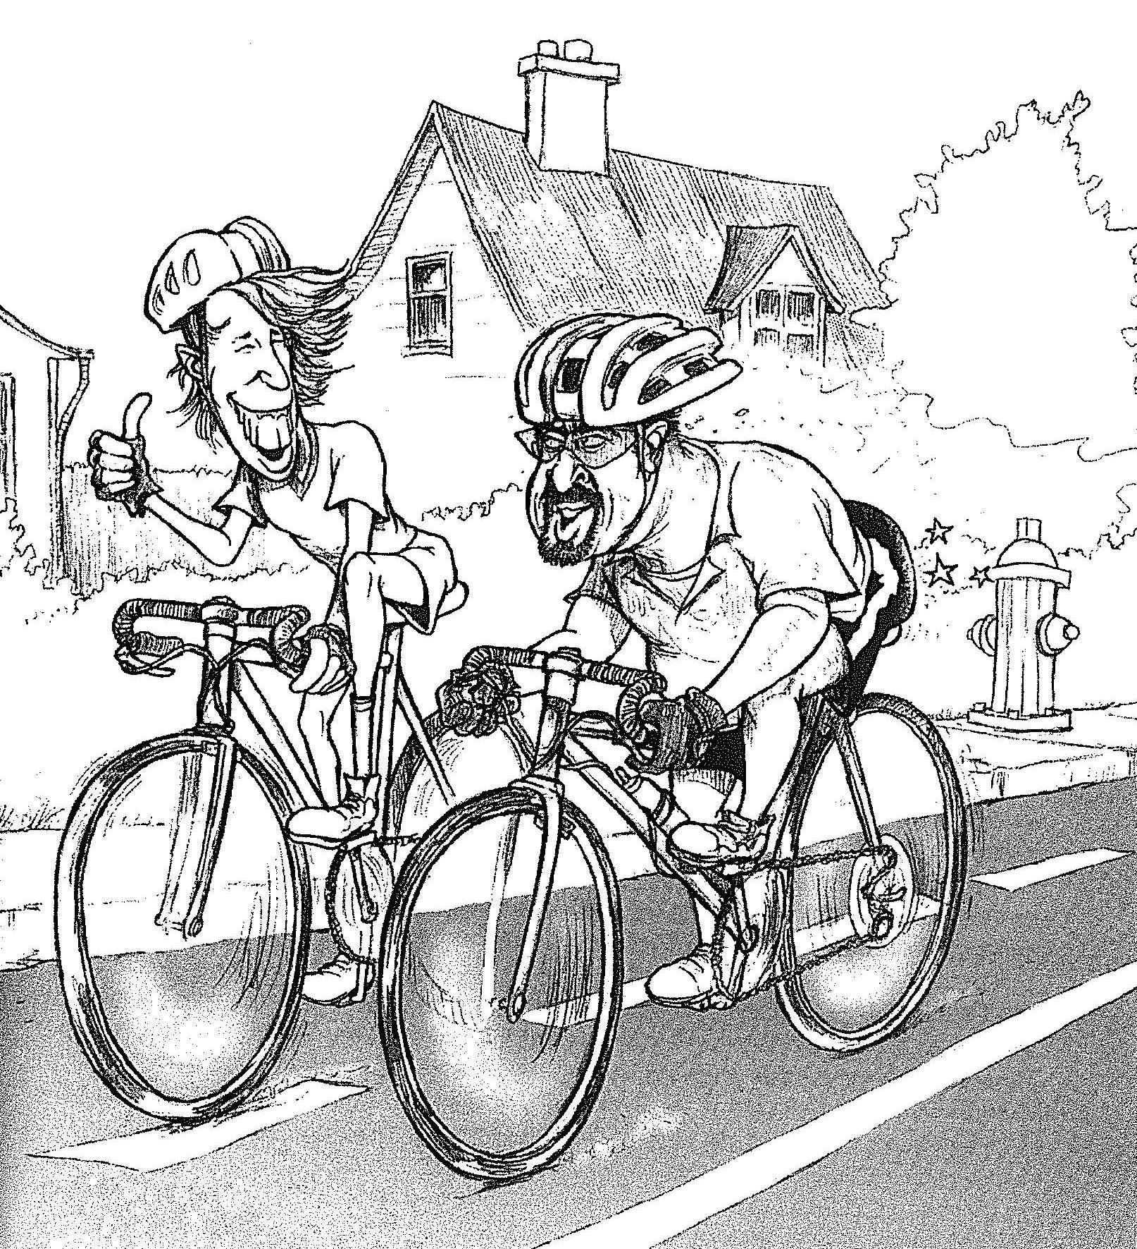
Three-headed happiness
Finding a balance
Worker guy
Dad guy
Biker guy

Slide 5
Three-headed happiness: Part 1 Your professional identity or sense of purpose
Why do you work?
Identify your purpose (to do something you love or to earn the means to an end you love)
You don’t need to be paid in order to have a sense of purpose
A niche is something that develops. Don’t expect to know it before you make any decision.

Slide 6
Three-headed happiness: Part 2 social attachments
Initiating and maintaining contact
Why is it so natural at work or in school?

Slide 7
Three-headed happiness: Part 3 Nurturing your passions and interests
Invest in yourself! Try things out before you decide
Allow interests time to develop (music, sport, books, etc). Did any of your current interests start off with a bang?

Slide 8
Check your balance
If you overdo part 1, where do you borrow the time from?
Usually part three is the first to go
Followed quickly by part two
Make no decision without considering the whole

Slide 9
This sucks! What are my options?
Step one: change it
Step two: accept it
Step three: reject it
Whatever you do, choose one.
Notes:
Ex., Drinking husband, wages, cancer

Slide 10
Some important issues affecting mental health
Attributions and self-confirming biases
Rigidity
Unrelenting standards
Mistrust
Absolute thinking
Groupthink and segregation

Slide 11
Attributions
The cleaning lady
Put some slippers on!
Don’t let the cats in the garage!
Mistaken attributions make us think we have more control than we actually do and contributes to our exaggerated efforts to control everything

Slide 12
Rigidity
Toilet paper wars

Slide 13
Standards
Which doctor?
Two salespeople

Slide 14
Mistrust A self-fulfilling prophecy
Trust blindly and get burnt from time to time
Don’t trust and you will be miserable for life

Slide 15
Absolute thinking
Anxiety? Why did I get that thought, what’s that pain? Some blow it off, others freak out
Depression
Anger

Slide 16
Groupthink
The fuel of hatred
The charter of “values”
Contact and stigma in mental illness
Patriotism is your conviction that this country is superior to all others because you were born in it. – George Bernard Shaw

Slide 17
Lack of confidence
Competence and confidence
Six math problems
A new planet: your skills are in you

Slide 18
What’s wrong with me?
Does this question ever make you feel good?

Slide 19
Learning from your successes
When was the last time you guys got along?
…were calm
…liked your job
Analyse not only your situations but the attitude you had at those times

Slide 20
Death and the lives of the dead
Why does Ode to Joy still give me goosebumps?
Have you ever gotten advice from a loved one?
We die two times: when our bodies die and when our name is mentioned for the last time.

Slide 21
Should we listen to our emotions? My best advice
Do what makes sense (i.e., what is in your best interest) despite what your emotions are telling you

Slide 22
Three plus one
Finding nirvana in a cup of coffee

Slide 23
Not much chance, completely cut loose from purpose, he was a young man riding a bus through North Carolina on the way to somewhere and it began to snow and the bus stopped at a little café in the hills and the passengers entered. He sat at the counter with the others. He ordered and the food arrived. The meal was particularly good, and the coffee. The waitress was unlike the women he had known. She was unaffected. There was a natural humor which came from her. The fry cook said crazy things. The dishwasher in back laughed, a good clean pleasant laugh. The young man watched the snow through the window. He wanted to stay in that café forever. The curious feeling swam through him that everything was beautiful there, that it would always stay beautiful there. Then the bus driver told the passengers that it was time to board. The young man thought, I'll just sit here, I'll just stay here. But then he rose and followed the others into the bus. He found his seat and looked at the café through the bus window. Then the bus moved off, down a curve, downward, out of the hills. The young man looked straight forward. He heard the other passengers speaking of other things, or they were reading or attempting to sleep. They had not noticed the magic. The young man put his head to one side, closed his eyes, pretended to sleep. There was nothing else to do-just to listen to the sound of the engine, the sound of the tires in the snow.
- Charles Bukowski: “Nirvana”

Slide 24
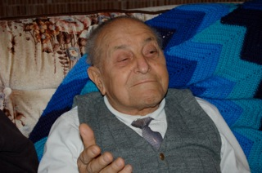
Three plus one plus one
“What are you going to do? That’s life. Whatever comes, we’ll take.”
- Giuseppe Zacchia

Slide 25
I invite your comments: www.blog.douglas.qc.ca/psychospeak
Questions: camillo.zacchia@douglas.mcgill.ca
Website:
www.drzacchia.com
Twitter: @camillozacchia

