Slide 1
McGill Conference on International Aviation Liability & Insurance
April 17 – 18, 2015
Hotel Bonaventure Montreal Montreal, CANADA

Slide 2
Protection of Safety Information Saturday, April 18. 10:50 – 12:00
Moderator: Kenneth P. Quinn – Pillsbury Winthrop Shaw Pittman LLP
Panelists:
John Illson – ICAO Chief of Operational Safety Section
Steven C. Marks – Podhurst Orseck PA
Tatiana Pak - Technical Officer ANB, ICAO
Philippine Dumoulin – McGill IASL

Slide 3
Protecting Safety Information
Open Records Act/FOIA-type laws
Enforcement proceedings
Disciplinary actions
Civil litigation
Criminal prosecution

Slide 4
ICAO Legal Framework on Safety Information Protection
ICAO Annex 13 Guidance on aircraft accident and incident investigation
5.10 – Recommends the cooperation between safety investigators and judicial authorities.
Records shall not be made available for purposes other than the accident investigation.
5.12 - Unless judicial authorities deems that the disclosure is necessary for the proper administration of justice.
And requires the protection of Cockpit Voice Recorders.

Slide 5
Need for Statutory Protection Example of a UK case
Hoyle v. Rogers: entirety of accident report to be admitted into civil litigation to establish liability.
AAIB reports admissible as evidence for “its record of factual evidence […] and its expert opinion”.
Very permissive regarding access and use of safety information.
AAIB and IATA both supported reversal.

Slide 6
Safety Data v. Safety Information
Safety Data: set of safety values collected from various aviation sources and activities such as:
Accident/Incident investigation
Safety reporting
Inspections, audits, and surveys, findings
Safety stuides and reviews.
Safety Information: data processed, organized or presented to make it useful for the purpose of sharing, exchanging or retaining them for safety management.

Slide 7
Voluntary v. Mandatory Reporting
Voluntary Reporting:
Creation of an atmosphere of trust so that both front-line employees and management feel free to come forward to admit mistakes without fear of retribution or reprisal: ASIAS, FOQA, ASAP
Mandatory Reporting:
Affirmative reporting systems for incidents like failure malfunctiion and defects—incentive is to require with law

Slide 8
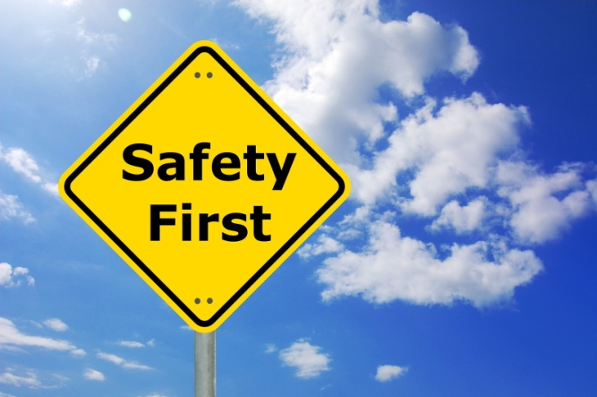
ICAO Safety Information Protection Task Force
Safety information must not be used for disciplinary proceedings, enforcement actions, civil litigation, or criminal prosecution unless to maintain or improve safety.
To ensure continued availability so that proper and timely preventive, corrective, or remedial actions can be taken for aviation safety.
Limit use in prosecution only where evidence exists of wilful misconduct or gross negligence.

Slide 9
Timeline of ICAO Safety Information Protection Task Force
December 2010: the ANC created the Safety Information Protection task force To provide recommendations and guidance.
2010 ICAO Resolutions 37-2 & 37-3
Instruction to Council to develop issues raised by the multidisciplinary group.
2010 ICAO High Level Safety Conference
Proposal for a multidisciplinary group to protect safety information and records.
2004 ICAO Assembly Resolution A35-17
Instruction to Council to develop legal guidance that will assist States to protect information gathered while allowing for the proper administration of justice.
ICAO 2013 Assembly Resolutions A38-3 & 38-4
Instruction to Council to take into account the findings & recommendations of the task force for the provisions of the future Annex 19.

Slide 10
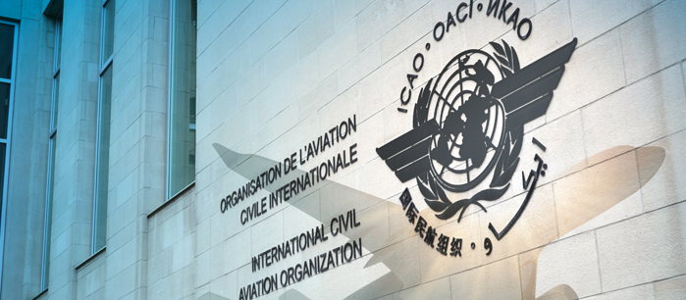
17 and 18 June 2014: the ANC accepted the recommendations of the SIP task force to send them to Contracting States and appropriate international organizations.
7 July 2014 State letter
Proposals to be sent in a State letter subject to comments and changes from ICAO Member States.
November 2014
Meeting to coordinate with the Safety Management Panel (SMP).
June 2015
Preliminary review by the ANC and envisaged for adoption in 2016.

Slide 11
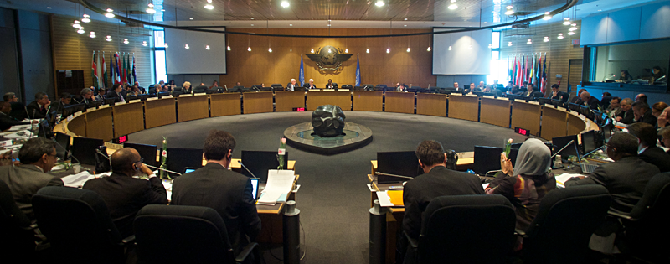
Need for a Balancing Test
No State shall make available or use safety information or data for other than safety-related purposes,
unless exceptionally, if an appropriate authority (judicial or non-judicial with safety expertise) determines that the value of its disclosure or use in any particular instance outweighs the likely adverse impact such action will have on aviation safety.

Slide 12
Recent developments in the European Union
EU Regulation 376/2014 on the reporting, analysis and follow-up of aviation occurrences in civil aviation
(Amend EU Regulation 996/2010 on investigation and prevention of accidents and incidents in civil aviation)
Need voluntary (art. 5) and mandatory (art. 4) reporting system.
Report, collect, store, protect (de-identify), exchange, disseminate, and analyze safety information.
Implementation by relevant aviation safety authorities of the Member States, Organizations as part of their Safety Management Systems, and the European Aviation Safety Agency
EU differs on protection of both voluntary and mandatory reporting, and focuses more on protecting individuals, not organizations, with deference to national/civil laws.

Slide 13
Extent of Protection
Individuals vs organizations
Accident vs incident reports
CVR and image recordings
Legislation vs training
Civil law vs common law

Slide 14
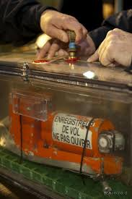
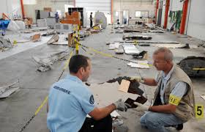
Need for Advanced Arrangements
Urging States to coordinate between:
Judicial authorities: law enforcement bodies, prosecutors & judges, and
Safety authorities: accident Investigation authorities, and
SMS stakeholders.
Each State shall promote the establishment of safety information:
Sharing networks among users of the aviation systems, and
Facilitate the free exchange of safety information.
Allow States the flexibility to draft their laws and regulations in accordance with their national policies.

Slide 15
Next Steps
ICAO action
National legislation
Judicial precedent
Penalties against those who misuse protected safety information.

Slide 16
Questions?
Kenneth P. Quinn
(202) 468-1056 Cell
(202) 663-8898 Office
kquinn@pillsburylaw.com

