Slide 1
NAV CANADA INSURANCE PRESENTATION
Leigh Ann Kirby VP – General Counsel and
Corporate Secretary

Slide 2
ABOUT NAV CANADA
Private, non-share capital company
Second largest ANSP in the world
12 million aircraft movements annually
18 million square km of airspace
Regulated by federal government on safety performance

Slide 3
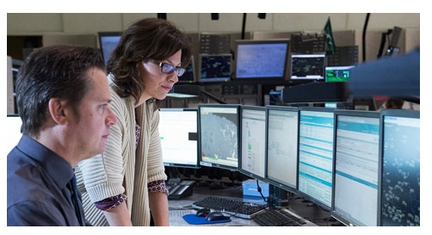
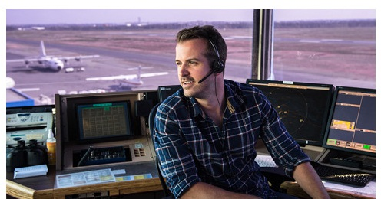
OUR PEOPLE
4,800 employees across the country
OUR SERVICES
Air traffic control
Flight information
Weather briefings
Aeronautical information
Airport advisory services
Electronic navigation aids

Slide 4
The ans transfer
Private company: Canada Not-for-profit Corporations Act
Purchased from federal government: $1.5 billion in 1996
No equity; no government subsidies
Primarily supported through service charges
Financed through public bond markets
$1.75 billion in various debt maturities; AA credit ratings

Slide 5
OUR CUSTOMERS (± 40,000)
Airlines
Air Cargo Operators
Air Taxi, Air Charter Operators, Helicopter Operators
General and Business Aviation (30,000)
CANADIAN AIRSPACE CHARACTERISTICS
Vast distances
Climate varies from polar to temperate
Crossroads of global air traffic flows
Busiest oceanic airspace in the world
Unique northern airspace operations
Stimulus for innovation

Slide 6
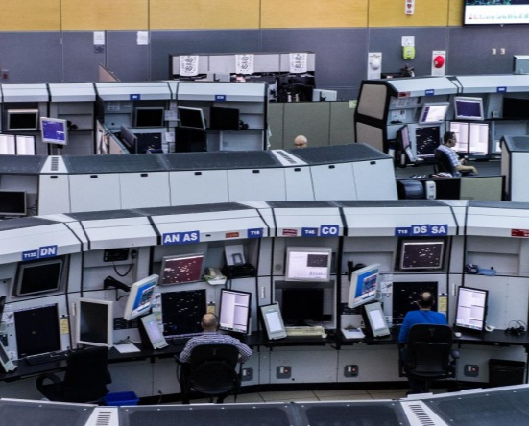
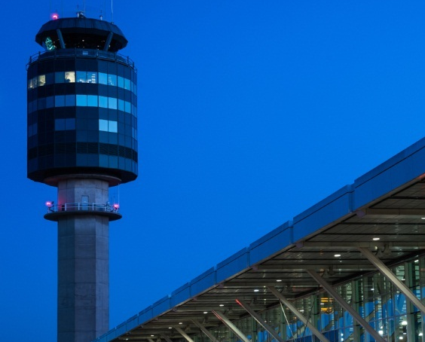
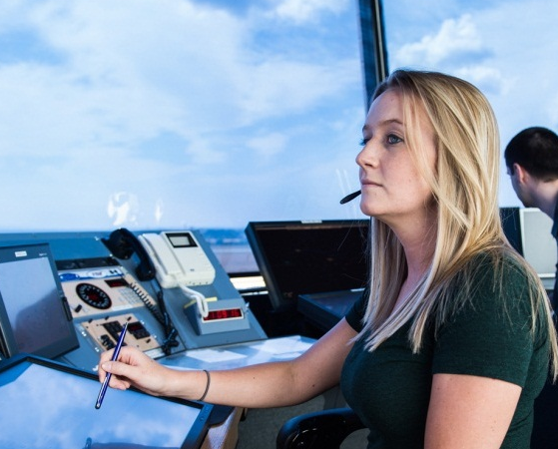
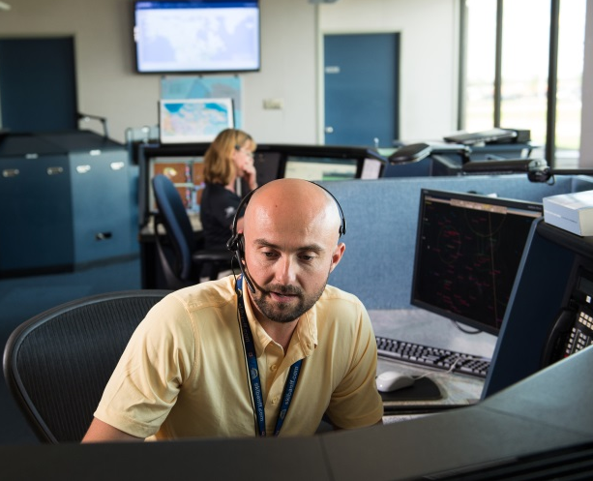
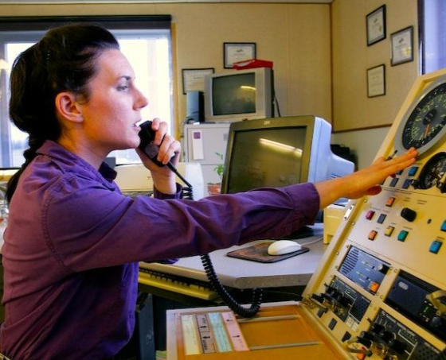
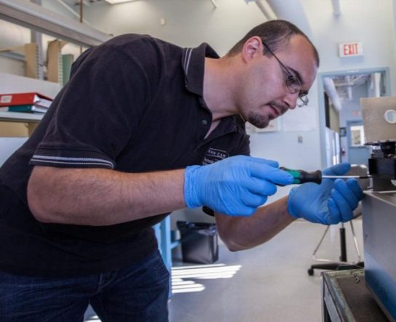
OUR FACILITIES
7 Area Control Centres
41 Air Traffic Control Towers
55 Flight Service Stations
8 Flight Information Centres
51 Community Aerodrome Radio Stations
31 Maintenance Centres

Slide 7
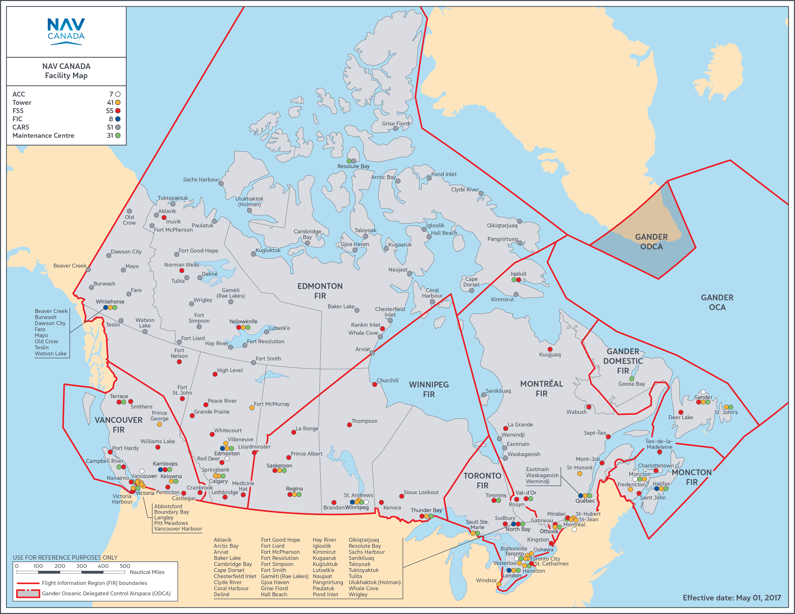

Slide 8
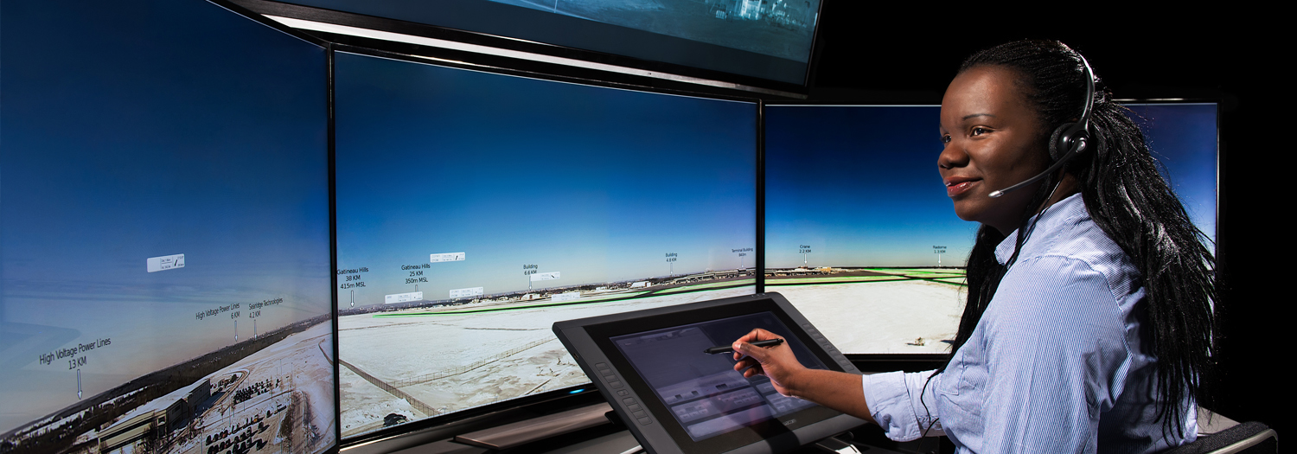
Primary Duty = maintain separation
of aircraft in the airspace that we control
-Safety is our Key Focus-
Related Operations
Development & sale of ANS technology worldwide
Joint ownership with NATS (UK) in Searidge – remote camera technology
Ownership interest in Aireon with Iridium Communications Inc, ENAV (Italy), Irish Aviation Authority and Naviair (Denmark) – offering first every complete pole-to-pole coverage and increased air operations capacity and efficiency

Slide 9
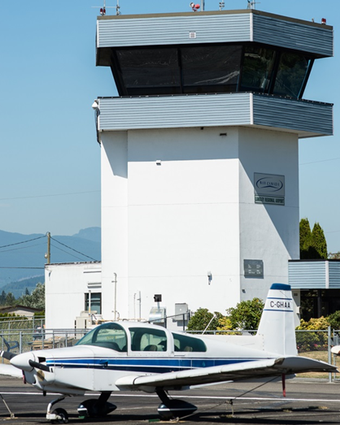
NAV’s Insurance Program
Hull & liability – (3 NAV owned Aircraft)
Aviation
War Liability
Non Aviation
NAV has a robust insurance program that protects
the organization from day to day risk as well as those
of a catastrophic nature
In order to obtain our target coverage limits NAV
has maximised coverage from Canadian domestic
insurers and has coverage underwritten with
insurers in foreign markets including Lloyd’s/London
Market and the European Market
To date, market capacity has not been an issue for
NAV on the basis of our claim history

Slide 10
Nature of INSURED Legal Claims against NAV
Aviation
NAV will often be named as a defendant in aircraft incidents where there is property damage or personal injury. In most cases, NAV is named with other co-defendants such as airport authorities, the airline and in some cases, the manufacturer (examples include – MK Airlines/Halifax, Air France/Toronto, Trans State/Ottawa, Air Canada/Halifax)
Non-Aviation
The most typical cases faced by NAV relates to motor vehicle accidents involving fleet vehicles and personal injury accidents (such as slip and fall incidents) at our facilities.
Non Aviation

Slide 11
THANK YOU

