Slide 1
UNDERSTANDING and Responding effectively to STUDENT STRESS
Nancy L. Heath, PhD
Notes:
Slide 1

Slide 2
PaRT II: Responding Effectively to Student STRESS
Nancy L. Heath, PhD
Notes:
Slide 2

Slide 3
Overview of the presentation
Background
Review of Part I: Understanding and Identifying Stress
Strategies
Strategies for stress management
Classroom Applications
How to use these in a regular classroom day
Specific situations for use
Concluding Comments
Importance of responding effectively to stress
Notes:
Slide 3

Slide 4
Background: Review
Notes:
Slide 4

Slide 5
Review of PaRT 1
BACKGROUND
Stress is an internal experience we have when we perceive the demands of the situation are greater than we can cope with.
Notes:
Slide 5

Slide 6
Review of PaRT 1
BACKGROUND
Stress is an internal experience we have when we perceive the demands of the situation are greater than we can cope with.
Stress can manifest in multiple ways.
Emotional
Psychological
Physical
Behavioural
Notes:
Slide 6

Slide 7
Review of PaRT 1
BACKGROUND
Stress is an internal experience we have when we perceive the demands of the situation are greater than we can cope with.
Exhaustion
Stress can manifest in multiple ways.
Stress levels vary along a continuum.
Relaxed
Anxiety/panic/anger
Performance
Inactive
Breakdown
Too little stress
Optimal
Stress
Stress Overload
Burnout
Stress Level
Notes:
Slide 7

Slide 8
Review of PaRT 1
BACKGROUND
Stress is an internal experience we have when we perceive the demands of the situation are greater than we can cope with.
Stress can manifest in multiple ways.
EVENT
Stress levels vary along a continuum.
STRATEGIES
We can intervene before, during, or after the stress response.
BEFORE
DURING
AFTER
Notes:
Slide 8

Slide 9
sTRATEGIES
Notes:
Slide 9

Slide 10
Emotion regulatory Stress management Strategies
STRATEGIES
STOP, THOUGHT CHALLENGE
PROGRESSIVE MUSCLE RELAXATION
BREATHING
MINDFULNESS
SELF-CARE
Notes:
Slide 10

Slide 11
Cognitive Behavioural: Thought Challenge
STRATEGIES
For self-critical rumination or repetitive negative thoughts.
I am so stupid!
Student visualizes a stop sign
Which indicates to stop and take a deep breath
And challenge the critical thought as if they were their own best friend.
Notes:
Slide 11

Slide 12
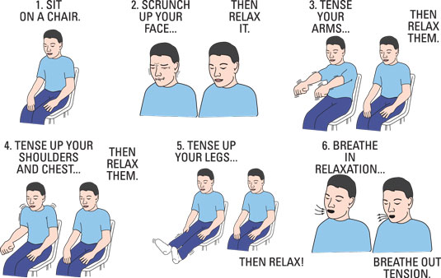
PROGRESSIVE MUSCLE RELAXATION
STRATEGIES
Progressive Muscle Relaxation
Physically turns off the stress response. No cognitive requirements. Can be done anywhere.
Involves tensing and then relaxing each muscle group in the body.
As you tense-relax you focus on and notice the FEELING of the muscles.
Notes:
Slide 12

