Slide 1
Amir Raz Canada Research Chair Montreal Neurological Institute Jewish General Hospital McGill University

Slide 2
What is the theme?
The Science of Hypnosis
Top-Down versus Bottom-Up

Slide 3
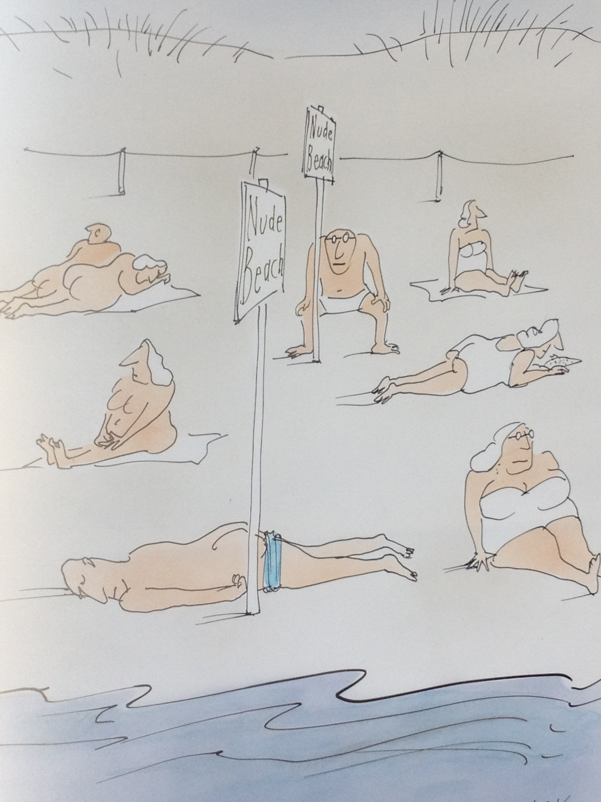

Slide 4
A few things to ponder:
Most people are confused about top-down effects.
Most clinicians and health care practitioners are largely unfamiliar with top-down effects.
Non-drug parameters influence response.
The behavioural and social sciences provide good insights into top-down effects.
Diagnosis, reassurance, attention, etc. are forms of treatment.

Slide 5
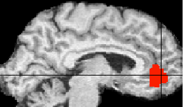
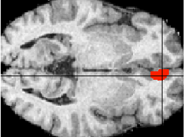
Szechtman et al. (1998)
86
83
Adjusted rCBF (ml/dl/min)
80
77
Baseline
Hear
Imagine
Hallucinate
Area differentially activated by hallucination and hearing vs. imagine and baseline under hypnosis
Notes:
What brain mechanisms underlie hallucinations?
Compared 2 groups of high hypnotizables: hallucinators vs. nonhallucinators.
Question: Which brain regions take part in distinguishing whether an event come from the external world or not?
rCBF in 4 conditions during hypnosis: rest, listening, imagining, and hallucinating.
Subjective ratings of externality and clarity.
Activation of the right anterior cingulate is critically implicated in the experience of a hallucination.
Activation of the auditory cortex alone is not a sufficient basis for a hallucination.
Consistent with other evidence suggesting the role of the anterior cingulate in hallucinations.

Slide 6
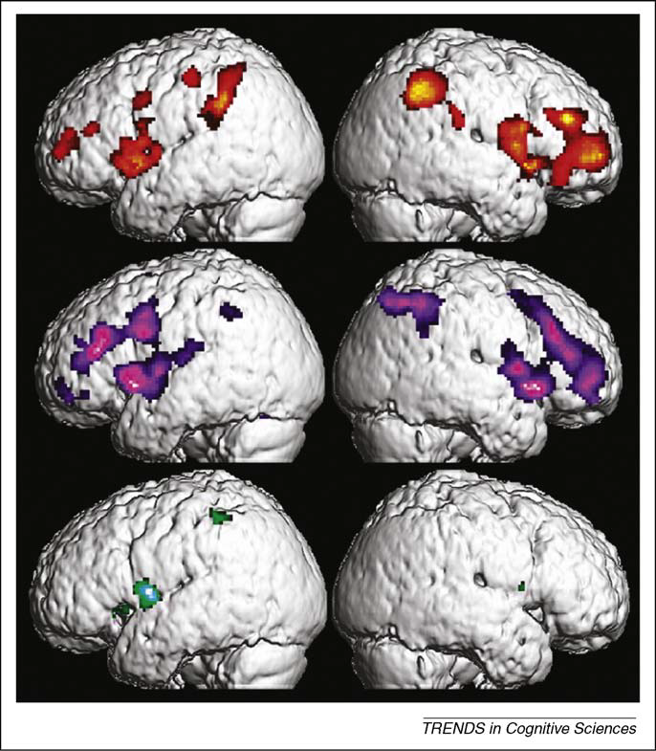
Derbyshire et al. (2004)
Hypnotically suggested pain (top), physically induced heat pain (middle), and imagined pain (bottom)

Slide 7
Raz et al. (2005)
Prefrontal and early visual processing occipital regions distinguish high-hypnotizables under post-hypnotic suggestion
Notes:
Raz, Fan, & Posner (2005)
High and low hypnotizables, as determined by pre-screening on HGSHS:A and SHSS:C.
Subjects given posthypnotic suggestion that words would look like meaningless symbols, and then run in the Stroop task.
Neural activity scanned with both fMRI and ERPs.
Posthynotic suggestion in high hypnotizables eliminated Stroop effect.

Slide 8
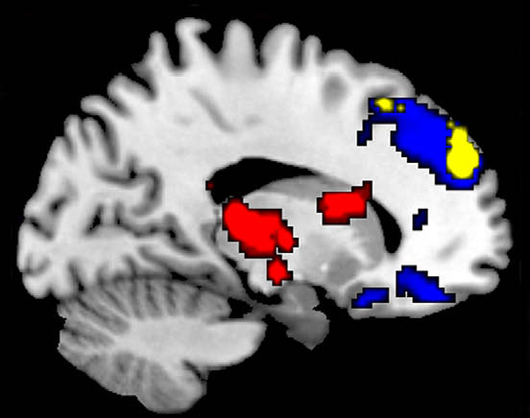
McGeown et al. (2009)
Areas of reduced activation under resting brain training: Blue = high hypnotizables; red = low hypnotizables; yellow = more deactivation in highs than in lows
Notes:
McGeown et al. (2009)
Question: In high-hypnotizable subjects, does resting hypnosis reduce activation in the default mode network (DMN)?
DMN involves several cortical midline structures, including anterior cingulate and ventral and dorsal medial prefrontal cortex.
High and low hypnotizable subjects, in and out of hypnosis.
fMRI to record brain activity while subjects were passively looking at a visual stimulus.

Slide 9
MAOA-LPR 4-repeat class (N=8) compared with 3-repeat class (N=8)
PNAS 2003

Slide 10
DRD4 insertion class (N=6) compared with deletion class (N=10)
PNAS 2003

Slide 11
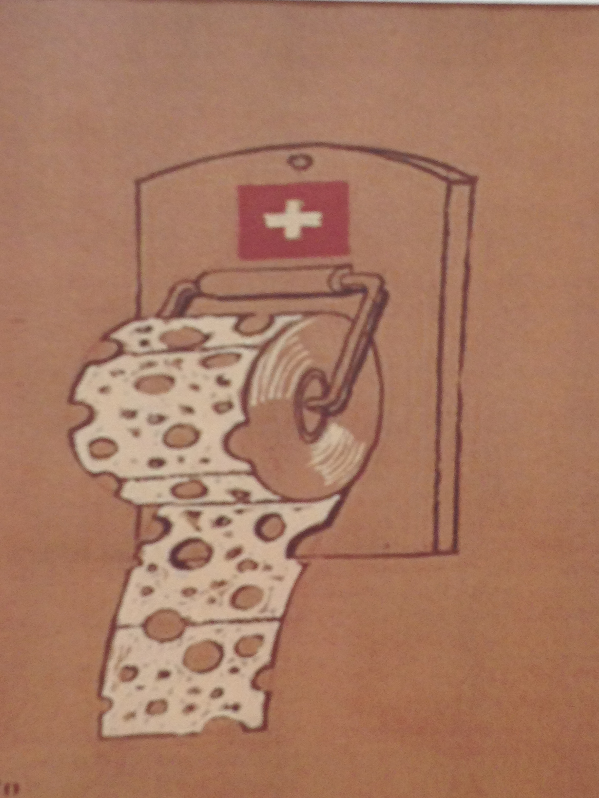

Slide 12
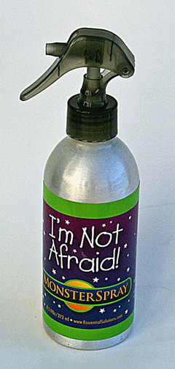
From the Brain to Monster Spray
http://bestproductsmediaguide.info/product.php?product_number=1201

Slide 14
Revisiting the definition of hypnosis
Kihlstrom (2012):
Hypnosis is a social interaction in which one person, designated the subject, responds to suggestions offered by another person, designated the hypnotist, for imaginative experiences involving alterations in conscious perceptions and memory, and the voluntary control of action. In the classic instance, these experiences are accompanied by subjective conviction bordering on delusion, and feelings of involuntariness bordering on compulsion.

Slide 15
But Is this definition specific to hypnosis?
Courtship is a social interaction in which one person, designated the subject, responds to suggestions offered by another person, designated the suitor, for imaginative experiences involving alterations in conscious perceptions and memory, and the voluntary control of action. In the classic instance, these experiences are accompanied by subjective conviction bordering on delusion, and feelings of involuntariness bordering on compulsion.

Slide 16
SCIENCE People, including scientists, often ask unscientific questions: Do you believe that hypnosis can reduce pain? Do you suppose that suggestion can help depression?

Slide 17
Pristine scientists do not believe or suppose. Instead, they look at the data and ask whether the evidence supports the hypothesis. At least in theory, beliefs should be immaterial to the results of experiments, because science is about empirical evidence.

Slide 18
#1 Science is mistakenly taken to be the name of a set of established truths.
Critical Misconceptions about Science
It is NOT that.

Slide 19
#2 Science is the name of a set of materialist and reductionist propositions. There is no place in science for qualitativeness, subjectivity, unity, intentional causation, etc.
Critical Misconceptions about Science
It is NOT that either.

Slide 20
Science is the name of a set of institutional structures wherein techniques and methods have evolved over the past several centuries for improving our knowledge. Science is one of the most stunning achievements of our species.
Instead
Notes:
In this sense, any systematic study, any rigorous investigation of some phenomena fits the definition of science.

